Slide 1
Loader
A loader is a system program that takes the compiled object/machine codes from storage and places it into main memory such as RAM. It also performs the necessary address binding, linking, and relocation so the program can execute properly.
Functions of Loader
Loading – Brings the program from secondary storage into main memory.
Relocation – Adjusts program addresses so they match the actual memory space where the program is loaded.
Linking – Resolves symbolic references.
Allocation – Reserves memory space for the program’s code, data, and stack.
Execution Start – Transfers control to the starting instruction of the program.

Slide 2
Types of Loader
Absolute Loader- Loads the program into a fixed, pre-assigned memory location.
Relocating Loader- Can load programs anywhere in memory by adjusting addresses.
Linking Loader- Performs linking, relocation and loading at the same time.
Dynamic Loader- Loads modules on demand, only when needed during execution.

Slide 3
Linker
Linker is a system program that combines multiple object files and libraries into a single executable file.
Jobs performed by Linker
Symbol Resolution- It matches function calls and variable references with their actual definitions.
Relocation- Adjusts memory addresses of code and data so that all data and code fits into memory.
Library Linking- Adds code from into program.
Combining Modules- The linker merges their object files.

Slide 4
Types of Linking
Static Linking- When function calls are linked at compile time, this type of linking is known as static linking. For example a function call in programs is linked at the time of compilation.
Dynamic Linking- The linking to the required resources is performed during the execution of programs, known as dynamic linking. Dynamic method dispatch in OOPs is an example of this kind of linking, where method calls with the associated definitions get resolved at run time.

Slide 5
Algorithm
An algorithm is a set of instructions that is designed to accomplish a task. Algorithms usually take one or more inputs, run them systematically through a series of steps, and provide one or more outputs.
Algorithms are typically associated with computing and are an essential element of computer programming. Algorithms can be used to accomplish a variety of computational tasks, such as performing calculations or finding information in databases.

Slide 6
Characteristics of an Algorithm
Input
An algorithm should take zero or more inputs.
These inputs are taken from a specified set of values.
Output
An algorithm should produce at least one output.
The output is the solution/result of the problem.
Definiteness (Unambiguous)
Each step of the algorithm must be precisely and clearly defined.
No room for confusion or interpretation.
Finiteness (Termination)
An algorithm must always terminate after a finite number of steps.
It should not go into an infinite loop.
Effectiveness (Feasibility)
Each step of the algorithm must be basic enough to be carried out, in principle, by a person using pencil and paper.
Computation should be feasible with available resources.

Slide 7
Advantages of Algorithms
It is easy to understand.
An algorithm is a step-wise representation of a solution to a given problem.
In an Algorithm the problem is broken down into smaller pieces or steps hence, it is easier for the programmer to convert it into an actual program.
Disadvantages of Algorithms
Writing an algorithm takes a long time so it is time-consuming.
Understanding complex logic through algorithms can be very difficult.
Branching and Looping statements are difficult to show in Algorithms.

Slide 8
Algorithm to prepare a tea
Step 1: Start
Step 2: Get the ingredients WATER, MILK, SUGAR, TEA
Step 3: Boil the WATER and add TEA POWDER
Step 4: Add SUGAR and pour MILK
Step 5: Stir well
Step 6: Strain into cup
Step 7: A CUP OF TEA is ready to drink
Step 8: Stop

Slide 9
Algorithm to find maximum of three numbers
Step 1: Start
Step 2: Read the three numbers, say A, B and C
Step 3: Check whether A is greater than B and C. If, so display A is biggest number and Stop
Step 4: Otherwise, check whether B is greater than C. If, so display B is the biggest number and stop.
Step 5: Otherwise, display C is the biggest number
Step 6: Stop

Slide 10
Calculating cut-off mark for N students
Step 1: Start
Step 2: Read the number of students
Step 3: Initialise the COUNT to 1
Step 4: If COUNT is less than or equal to N, Read MATHS, PHYSICS and CHEMISTRY marks of a student. Otherwise go to Step 10
Step 5: Calculate CUTOFF by dividing the MATHS mark by 2, PHYSICS and CHEMISTRY marks by 4 and adding them together (i.e.) CUTOFF= MATHS/2+PHYSICS/4+CHEMISTRY/4
Step 6: Increment the COUNT by 1
Step 7: Display the CUTOFF
Step 8: Initialise the CUTOFF to 0
Step 9: Go to Step 4
Step 10:Stop

Slide 11
Flowchart
A flowchart is a diagram that depicts the stages of a process, workflow, computer program or system. Flowchart diagrams consist of shapes connected by lines and represent step-by-step processes to aid in decision-making, reduce ambiguity and enhance workflows.

Slide 12
flowchart can aid in any of these tasks
Documenting a process or procedure
Brainstorming ideas
Business process management (BPM) and business process analysis (BPA)
Increasing clarity and improving communication between colleagues and teams
Outlining a decision-making procedure
Clarifying the reporting structure of an organization
Optimizing a process or workflow
Explaining how a process is done

Slide 13
Benefits of Flowcharts
Makes logic clear
Provide easy understanding
Effective analysis of the logic
Useful in coding
Enables proper testing and debugging
Provides better documentation and maintenance
Limitations of a Flowchart
Complex logic- leads to complex and clumsy flowcharts if the logic is complex
Difficult to modify

Slide 14
Symbols used in flowchart
 | INIT/START and HALT/STOP a process
 | To display calculation
 | Input and Output
 | Condition IF-ELSE
 | Flow of process

Slide 15
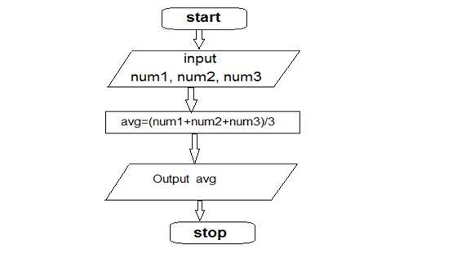
Flowchart to find average of 3 numbers

Slide 16
Pseudocode
A Pseudocode is defined as a step-by-step description of an algorithm. Pseudocode does not use any programming language in its representation instead it uses the simple English language text as it is intended for human understanding rather than machine reading. Pseudocode is the intermediate state between an idea and its implementation(code) in a high-level language.
Algorithm
Pseudocode
Program

Slide 17
Algorithm vs Pseudocode
Algorithm | Pseudocode
An Algorithm is used to provide a solution to a particular problem in form of a well-defined step-based form. | A Pseudocode is a step-by-step description of an algorithm in code-like structure using plain English text.
An algorithm only uses simple English words. | Pseudocode also uses keywords.
These are a sequence of steps of a solution to a problem. | These are codes and plain English text.
There are no rules to writing algorithms. | There are certain rules for writing pseudocode.
Algorithms can be considered as pseudocode. | Pseudocode cannot be considered as an algorithm.
Difficult to understand. | Easy to Understand.

Slide 18
Pseudocode to prepare a cup of tea
Begin
Get WATER, MILK, SUGAR, TEA
Boil WATER
Add TEA
Add SUGAR
Pour MILK
Stir
Pour into cup
Serve TEA
End

Slide 19
Pseudo code to find largest number in a list of N numbers
Begin
Get N
Get NUMBER
BIGGEST <= NUMBER
For COUNT <= 2 to N
Get NUMBER
If NUMBER>BIGGEST then
BIGGEST - NUMBER
Endif
Endfor
Display BIGGEST
End

Slide 20
Factorial of a number
Algorithm | Pseudocode
Step 1: Start Step 2: Initialize I to 1 and FACT to 1 Step 3: Read no to find factorial say N Step 4: Multiply FACT and I, store into FACT Step 5: Increment I by 1 Step 6: If I greater than FACT then go Step8 Step 7: Goto Step 4 Step 8: Display the value of FACT Step 9: Stop | Begin Get N FACT <- 1 For I <- 1 to N FACT <- FACT*I Endfor Display FACT End

Slide 21
Flowchart(Factorial of a number)
INIT
FACT=1, I=1
READ N
FACT=FACT*I
I=I+1
IF I<=N
YES
NO
PRINT FACT
STOP
For Students- Write Algorithm, Pseudocode and Flow Chart of Fibinacci Series.

Slide 22
Structure of C Programs
A C program fallows fallowing structure:
Documentation Section-
Contains comments about the program.
Link Section-
Includes header files required by the program.
Definition Section-
Defines constants and macros.
Global Declaration Section-
Declare global variables and function prototypes.
main() Function Section-
The starting point of every C program.
It contains Variable Declarations and Executable Statements
Subprogram Section (Functions)-
User-defined functions written after main().

Slide 23
Writing and executing the first C program
#include <stdio.h>
int main() {
printf("Hello, World!");
return 0;
}
Explanation of the Program
#include <stdio.h> Includes the Standard Input Output library.
int main() Entry point of every C program.
printf("Hello, World!"); Displays the text on the screen.
return 0; Ends the program successfully.
To create program open gedit on Linux and enter the code.
Save the file as hello.c or desired_name.c
To compile open shell and type cc name.c (exp-$cc hello.c)
The object file created by name a.out
To execute the file type a.out (exp- $a.out)

Slide 24
Syntax and Logical Error
Syntax means the set of rules that defines how instructions in a programming language must be written. Syntax rules in programming language ensure that the program is valid and understandable by the compiler. If rules are broken then syntax error generated.
Semantics is about the meaning of a statements, what the program does when it runs. It Focuses on Logic (behavior) of the program. If semantics are wrong, the program compiles successfully but produces incorrect results (logical errors).
Syntax Errors: are the errors that occur when you violate the rules of writing C syntax are known as syntax errors. The compiler error indicates something that must be fixed before the code can be compiled. All these errors are detected by compiler and thus are known as compile-time errors. Missing Parenthesis (}), Printing the value of variable without declaring it, Missing semicolon etc are reason of Syntax errors.
Logical Errors : On compilation and execution of a program, desired output is not obtained when certain input values are given. These types of errors which provide incorrect output but the code appears to be error free are called logical errors.

Slide 25
Components of C Language…
1. Character Set- The set of characters supported by any programming language. C programs are built from characters such as:
Letters- A–Z, a–z Digits- 0–9 White spaces- space, tab, newline
Special symbols- (+ - * / \ % ; : , . { } ( ) [ ] # " ‘ ) & | ! < > ? _ etc.
2. Tokens- Tokens are the smallest unit of a C program. Types of tokens:
Keywords- Reserved words having predefined meaning to the compiler. C provides 32 keywords. e.g., int, if, while, return.
Identifiers- Names for variables/Constants, functions, arrays etc.
Literals/Constants- Fixed values such as \n, \a, \f, 10, 3.14, 'A‘ etc.
Operators- Symbols that perform operations such as +, -, *, /, ==, = etc.
Punctuation/Special Symbols- ; , { } ( ) [ ] #.
3. Variables- Named memory locations used to store data. Exp: int x=10;
4. Data Types- Define the type of data a variable can hold. The basic types includes int, float, char, double etc.
5. Operators- Symbols used to perform operations- + - * / % = etc.
6. Expressions & Statements- Expression are Combination of variables, constants, operators while Statement are Complete instruction that ends with ;.

Slide 26
Components of C Language
7. Functions- Blocks of code that perform specific tasks.
8. Control Structures- Control the flow of execution.
Decision-making: if, if-else, switch
Loops: for, while, do-while
Jump statements: break, continue, goto, return
9. Preprocessors- Directives that begin with #, processed before compilation.
10. Library Functions- Built-in functions provided by C libraries.
List of C Keywords
auto break case char const continue default
Do double else enum extern float
for goto if int long register return short signed sizeof static struct switch typedef union unsigned void volatile while

Slide 27
Standard I/O in C
Standard Input in C- Used to take data from the console.
1. scanf(): Reads input from the user.
Syntax: scanf("format_specifiers", &variable_list);
Example: int age; scanf("%d", &age); // reads an integer
2. getchar(): Reads a single character from input.
Example: char c; c = getchar(); // reads a character
Standard Output in C- Used to display data on the screen.
1. printf(): Prints formatted output on console.
Syntax: printf("format_specifier", variable);
Example: int sum = 25; printf("Sum = %d", sum);
2. putchar(): Writes a single character to output.
Example: putchar('A');

Slide 28
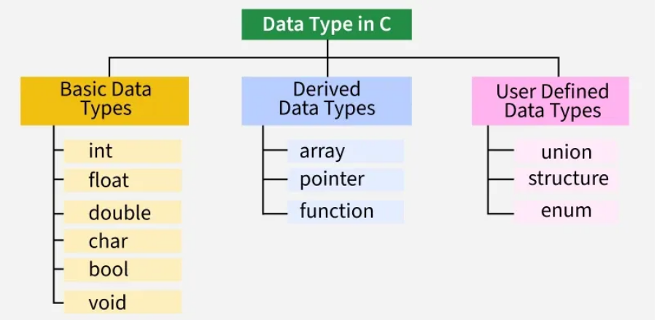
Fundamental Data Types

Slide 29
Variables and memory locations
A variable is a named memory location used to store data.
The name (identifier) is what you use in the program, and the memory location (address) is where the data is actually stored in RAM.
Variable name = label on a box
Memory location = actual storage space in RAM
Value = the content inside the box
Storage Classes
storage class defines- Scope, where the variable can be accessed (block, file, or program-wide), Lifetime - how long the variable exists in memory, Default Initial Value - what value it holds if not initialized and Storage Location where it is stored (RAM, CPU register, etc.).
C has 4 storage classes:
auto
register
static
extern

